Slide 1

Helping cities, utilities and communities
to accelerate e-mobility

Slide 2
EVseed’s Vision
A world where 100% of vehicles run on electricity and are fully integrated into the electric grid.

Slide 3
The Problem
The Electric Vehicle (EV) charging infrastructure is growing too slowly to accelerate EVs and the decarbonization of the transportation sector.
1
High level of Renewable Energy is leading to power grid congestions.
2

Slide 4



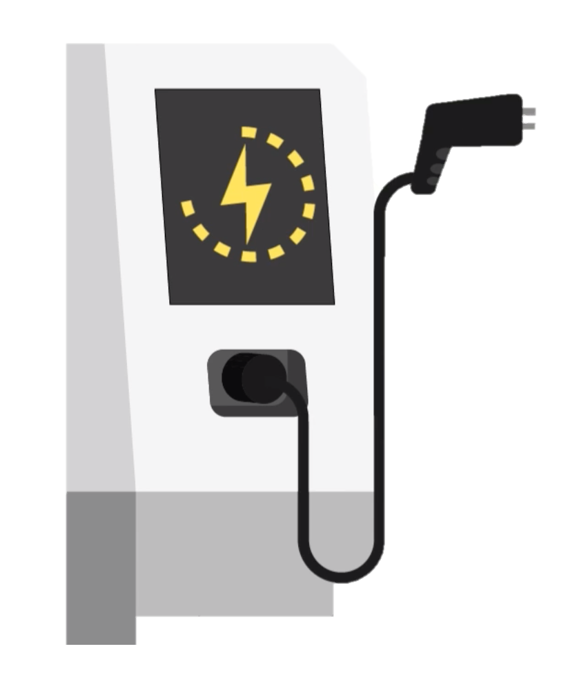


EVseed’s crowdsourcing and -funding
Utilities, Municipalities and Developers (UMD) suggest new EV public charging sites
Consumers can "vote with their dollars” on those sites
and gain electricity tokens for their investment
UMD build public charging points at sites with completed funding

Slide 5
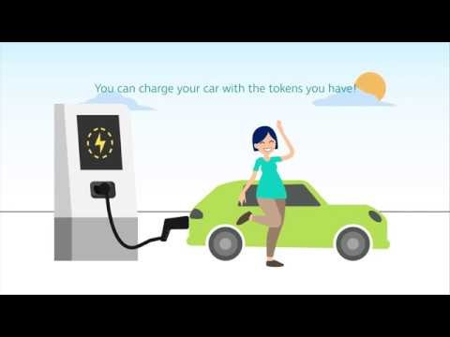

Slide 6
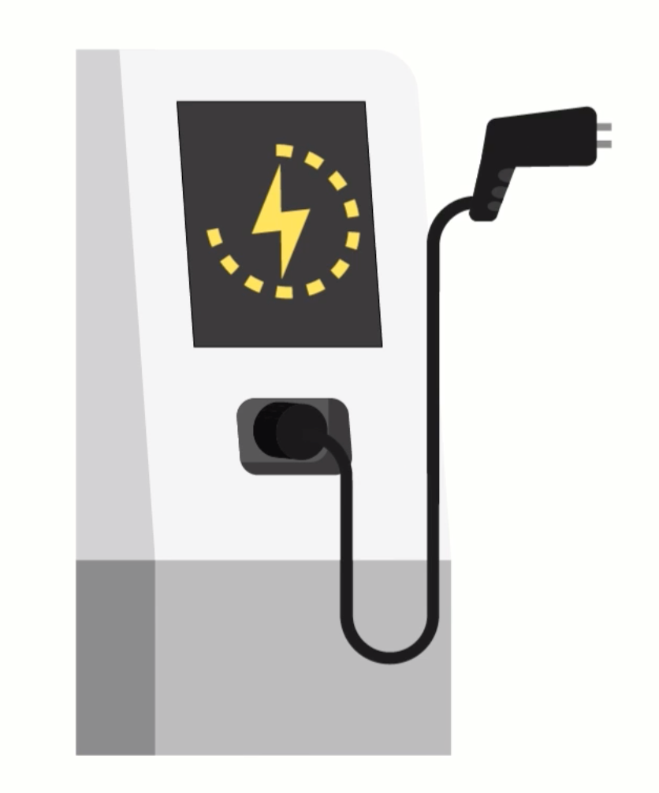

EVseed’s community system
electricity tokens
can be sold to other users
can be used to charge EVs, buy e-mobility services

Slide 7

EVseed’s next step: electric grid challenges
¹
With more and more intermittent renewable generation resources
utilities still need to guarantee the balance between generation and load
and are expected to invest $500B² in Transmission & Distribution assets by 2030.
¹ Solar 10 sec - CEIC-08-04 ² Total investment up to 2030 in the US and EU (source: https://www.iea.org/wei2018/)

Slide 8





EVseed’s next step: The Opportunity
EV batteries
Vehicle to Grid (V2G)
Deliver additional/ancillary services to the grid, e.g.:
Smart Charging
Shift charging at the right time, i.e. demand response
can provide grid services
spinning reserve,
frequency regulation, …
directly to system operators¹
¹ Transmission System Operators (TSO), Distribution System Operators (DSO), Independent System Operators (ISO)

Slide 9
EVseed’s next step: Ecosystem
Users
Charge Point Operators
EV fleet managers
Utilities
EV Manufacturers
Your challenge
Elaborate an effective business model among the stakeholders, based on EVseed’s technological architecture and the associated economic benefits.

